Slide 1
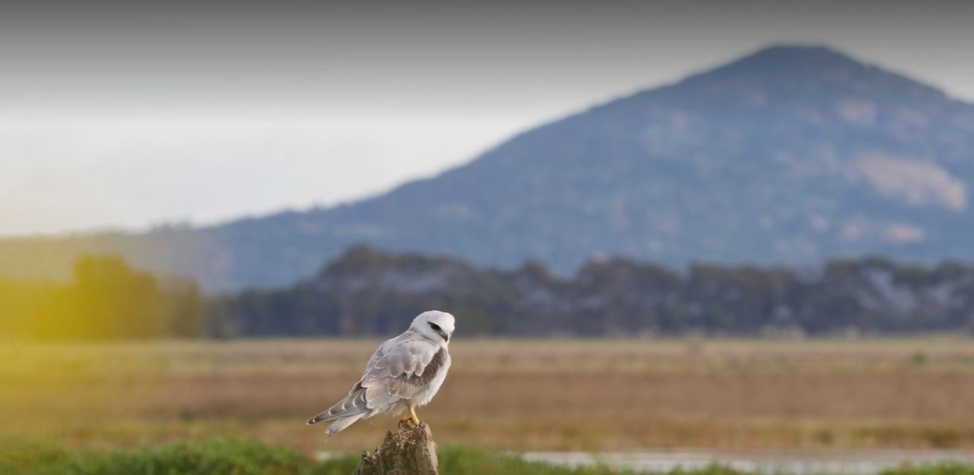
Socratic Seminar

Slide 2
Learning intentions
  For students to
Consolidate and share their understanding of the issue
Make connections between topics
Synthesise and apply their learning to produce a campaign

Slide 3
Task Instructions
Prepare for a Socratic seminar by planning a response to at least five of the discussion prompts.
During the seminar, contribute to the discussion on at least three of the discussion prompts
WTP Virtual Tour resource

Slide 4
A Socratic Seminar
What it should look like … | What it shouldn’t look like …
A natural flow among students and ideas Students prepared with notes, laptops and books Eye contact, body facing speaker and clearly engaged Honouring diversity of opinions Awkward silences are accepted as a natural part of process (lean into it!) Acknowledging and building on previous comments Staying focused on text and questions Intentional teacher intervention tactics such as muting, redirection Students taking turns as vocal leaders, facilitators, and/or intermittent participants Being attentive to each other, calling on quiet voices, making dominant voices wait their turn | Dominating voices Interrupting peers Treating it as a debate, trying to win and/or prove a point Resistant voices Side conversations Fiddling with papers, book, looking down, slouching Historical summary Ignoring who has participated and who has not Discouraging comments, humour, and/or body language Changing topics before all students have had the chance to participate

Slide 5
Discussion prompt
How do you feel about the predictions for Melbourne’s climate in the future?
WTP Virtual Tour resource

Slide 6
Discussion prompt
Can Melbourne avoid another drought, and if so, how?
WTP Virtual Tour resource

Slide 7
Discussion prompt
What could be the impact on Melbourne if we don’t conserve water?
WTP Virtual Tour resource

Slide 8
Discussion prompt
How do you think Climate Change will affect you?
WTP Virtual Tour resource

Slide 9
Discussion prompt
What are some of the challenges posed by population growth in Melbourne?
WTP Virtual Tour resource

Slide 10
Discussion prompt
Do you think Melbourne’s food security could be threatened by Climate Change?
WTP Virtual Tour resource

Slide 11
Discussion prompt
Will Melbourne keep growing forever?
WTP Virtual Tour resource

Slide 12
Discussion prompt
How might a drought and water restrictions impact the economy of Melbourne?
WTP Virtual Tour resource

Slide 13
Discussion prompt
What salary would you want to take a job as a ‘poo diver’?
WTP Virtual Tour resource

Slide 14
Discussion prompt
Is purified recycled water safe to drink and would you drink it?
WTP Virtual Tour resource

Slide 15
Discussion prompt
Should we give Victorians a referendum on adding recycled waste water to our water storages?
WTP Virtual Tour resource

Slide 16
Discussion prompt
How does water to contribute to the wellbeing of the community?
WTP Virtual Tour resource

Slide 17
Discussion prompt
How can recycled water be used to enhance the environment?
WTP Virtual Tour resource

Slide 18
Discussion prompt
If you were designing water restrictions, what would you restrict?
WTP Virtual Tour resource

